Slide 1

Build the Enlightened Enterprise
An Overview of the
Customer Evaluation Demo
Powered by JBoss Enterprise Middleware –
Business Rules Management System v5.3.1

Slide 2


JBoss BRMS Customer Evaluation Demo
Web-based development tools
(BRMS BRM)
Interacts with...
Decision
Service
Enterprise Application
Business Analysts
Business Process
Manager
Repository
Business Process Definitions
Business Rule & Event Definitions
Deploy
Java Code
Rule Engine
JBoss Developer Studio 5
Manage & Monitor
Developers
Business Data
Business Users
BRMS
Business Central
Operations

Slide 3
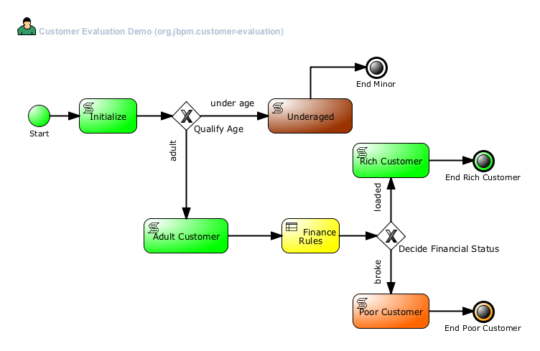
Customer Evaluation

Slide 4
Build the Enlightened Enterprise
For more information, please visit
http://www.jboss.com
Demo project available at:
http://github.com/eschabell/brms-customer-evaluation-demo
TITLE SLIDE: HEADLINE
Presenter name
Title, Red Hat
Date

